Slide 1
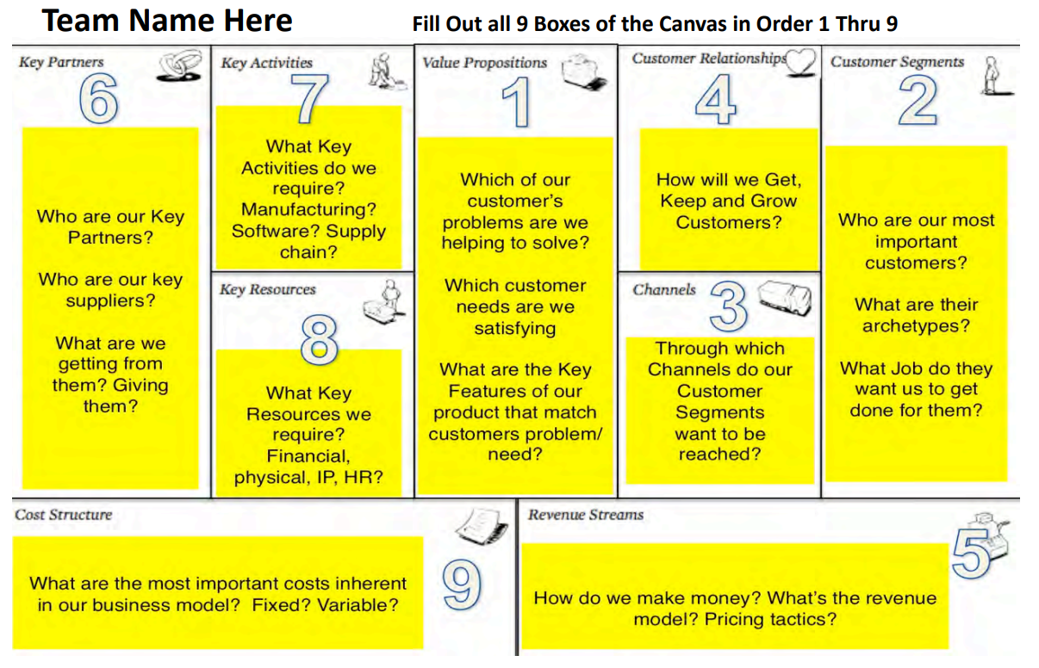
Business Model Canvas Guide

Slide 2
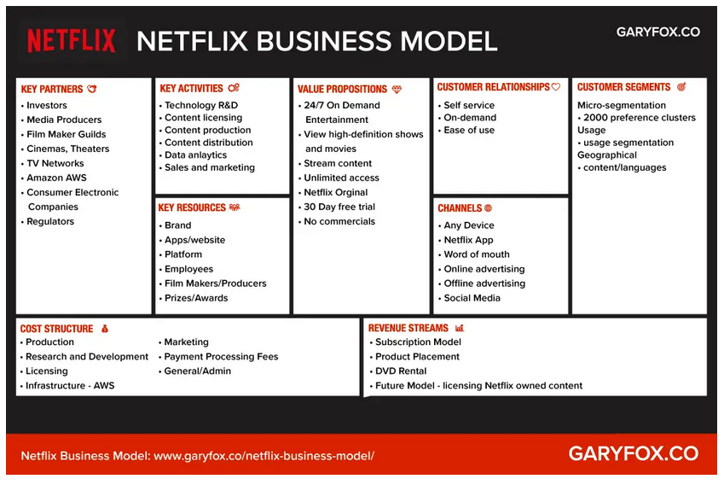
Example - Netflix

Slide 3
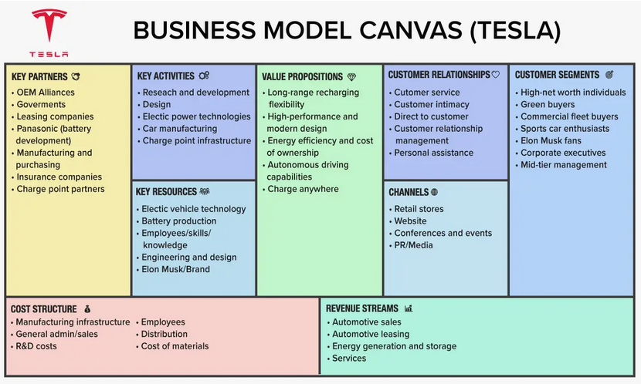
Example - Tesla

Slide 4
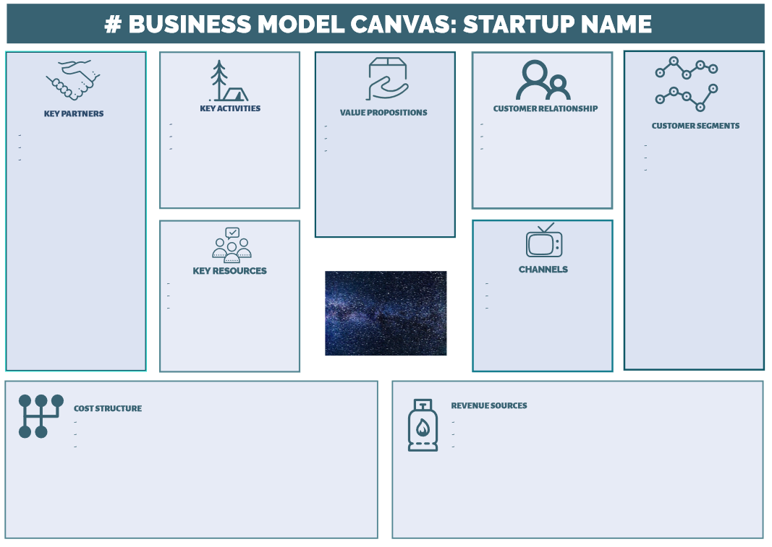
Your
Startup!

Slide 5
Business Model Canvas is a Tool
Find problems before they cost lots of money – fail fast!
Understand your customers and what value you provide to them
Determine economics of your product
How much does it cost to make?
How much does it cost to sell?
What are the fixed vs. variable costs?
Will revenues exceed costs?
Understand the scope of your enterprise and where you will need help

